Slide 1
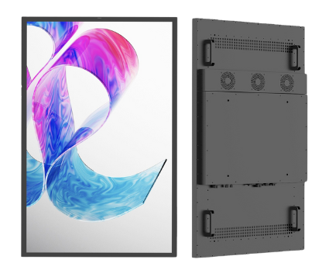
Placard VS/VP Retail Display…Single or Double Displays for Outdoor and Semi-Outdoor
Active Display Area | 55” | 65” | 75”
Resolution | 1080x1920 | 1080x1920 | 1080x1920
Orientation | Portrait | Portrait | Portrait
Aspect Ratio | 9:16 | 9:16 | 9:16
Brightness | 1500/2500 nits | 1500/2500 nits | 1500/2500 nits
Contrast | 1200:1 | 1200:1 | 1200:1
Viewing Angle | 178° | 178° | 178°
Display Colors | 16.7 million | 16.7 million | 16.7 million
Connectivity | Ethernet/Cellular/Wi-Fi | Ethernet/Cellular/Wi-Fi | Ethernet/Cellular/Wi-Fi
Environmental Rating | Semi Outdoor / Outdoor | Semi Outdoor / Outdoor | Semi Outdoor / Outdoor
Mounting | Wall frame, with floor-stand option | Wall frame, with floor-stand option | Wall frame, with floor-stand option
Mechanical Dimensions H x W x D | 49.7” x 28.9” x 3.3” | 58.3” x 33.7” x 3.3” | 67.05" x 38.67" x 3.39"
Weight | 75.2 lbs | 99.2 lbs | 172 lbs
Power (typical) | 280W | 320W | 380W
Power Supply | 120 ~ 240 VAC | 120 ~ 240 VAC | 120 ~ 240 VAC
IP Rating | 66 | 66 | 66
Glass (IK Rating) | 5mm Tempered IR Cut [IK10] | 5mm Tempered IR Cut [IK10] | 5mm Tempered IR Cut [IK10]
Operating Temperature | -4°F to 122°F | -4°F to 122°F | -4°F to 122°F
Certifications | CE, RoHS, ADA Compliance | CE, RoHS, ADA Compliance | CE, RoHS, ADA Compliance
Commercial-in-confidence ● Praevar Corporation
www.praevar.com

